Slide 1
INTELLIGENT VEHICLE DAMAGE ASSESSMENT AND COST ESTIMATOR FOR INSURANCE COMPANY APPLIED IN ARTIFICIAL INTELLIGENCE Final Review
Presented by,
Pranav R 192071062
Rajendran V 192071068
Rahul K 192071067
Sandeep Kumar R 192071076

Slide 2
CONTENTS
ABSTRACT
INTRODUCTION
DOMAIN SPECIFICATION
EXISTING SYSTEM
DISADVANTAGES OF EXISTING SYSTEM
PROPOSED SYSTEM
ADVANTAGES OF PROPOSED SYSTEM
AIM OF THE PROJECT
SYSTEM REQUIREMENTS

Slide 3
PROJECT DESCRIPTION
LITERATURE SURVEY
DATA FLOW DIAGRAM
SYSTEM ARCHITECTURE
CONCLUSION
FUTURE ENHANCEMENT
REFERENCE

Slide 4
ABSTRACT
Vehicle damage detection is one of the important prime activities in the insurance and vehicle rental industries.
The core technique of this system is object recognition.
This project presents a novel approach to measure the vehicle body damage and to make a cost prediction using 2D images.

Slide 5
INTRODUCTION
More than 27000 motor accidents take place in the world per annum.
In most of these accidents the drivers or the insurance policy holders have to spend a massive amounts of time to get the damage caused to the vehicle estimated.
The model is required to pass through multiple checks that would first ensure that given image is that of a car and to ensure that it is in fact damaged.
The model will predict the location of damage as in front side or rear, and the severity of such a damage as in minor, moderate or severe.

Slide 6
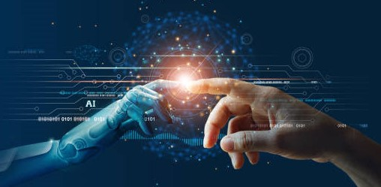
DOMAIN SPECIFICATION
Artificial Intelligence (AI) refers to the simulation of human intelligence in machines that are programmed to think like humans and mimic their action.
The term may also be applied to any machines that exhibits traits associated with a human mind such as learning and problem solving.
AI is being used today across different industries from finance to healthcare.

Slide 7
EXISTING SYSTEM
At present, as soon as vehicle meets with an accident and a damage is caused to the vehicle, the driver or the insurance policy holder contacts the insurance company and waits for their arrival to the place of the accident.
Once a relevant personnel arrive, a traditional approach is followed and the appraisal is calculated.
However, frequently the appraisal amount provided by the insurance companies are not sufficient to recover the damage caused.

Slide 8
DISADVANTAGES OF EXISTING SYSTEM
Time taking process.
Coverage failures.
Poor customer support.

Slide 9
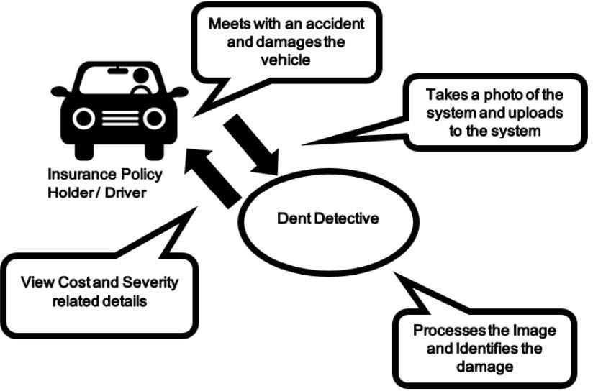
PROPOSED SYSTEM
The proposed system predicts the minor and major damages which are scratches, scrapes and dents on the vehicle body.
Once a damage image is uploaded to the system, the relevant damage is identified.
The illustration gives a brief idea about the flow of the proposed approach.

Slide 10
ADVANTAGES OF PROPOSED SYSTEM
It can be categorize the proportion of damaged parts and determine whether they need to be replaced or repaired.
It aids the user in expediting the process of filing an insurance claim for his vehicle.
Get a report with the vehicle's damage analysis created for you. To get compensation, submit the created report.
Process that saves time and money.

Slide 11
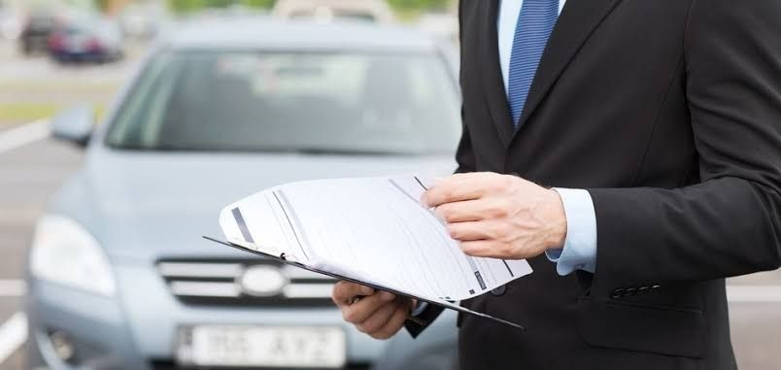
AIM OF OUR PRPJECT
The aim of this project is to build a VGG16 model that can detect the area of damage on a car.
The rationale for such a model is that it can be used by insurance companies for faster processing of claims if users can upload pics and the model can assess damage be it dent scratch from and estimates the cost of damage.
This model can also be used by lenders if they are underwriting a car loan, especially for a used car.

Slide 12

SYSTEM REQUIREMENTS
Software Requirements:
OS: Windows 10 or Higher
Python.
Anaconda.
Jupyter Notebook

Slide 13
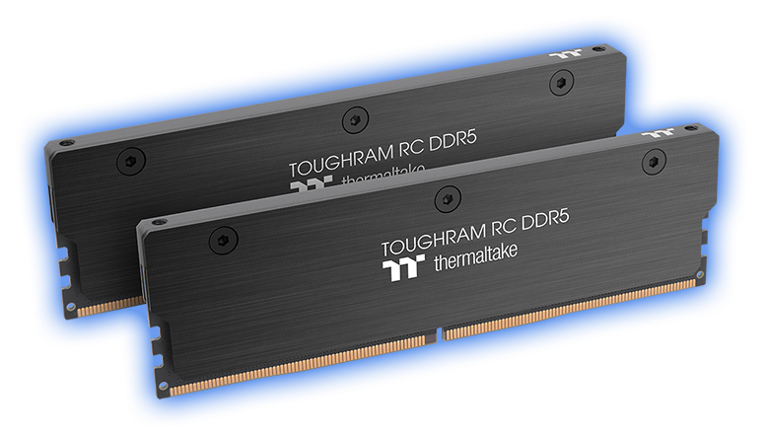
Hardware Requirements:
CPU Processor : Intel core i3 10th gen.
Primary Memory : DDR5 or DDR4 8GB RAM
Secondary Memory : HDD or SSD 200GB
GPU : nvidia GeForce 30 series.

Slide 14
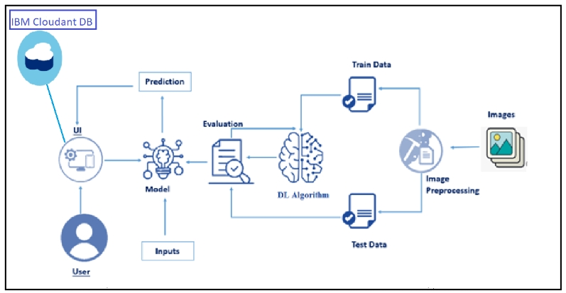
PROJECT DESCRIPTION
Nowadays, a lot of money is being wasted in the car insurance business due to leakage claims.
Visual examination and testing have been used to may these results. However, they impose delays in the processing of claims.
The diagram represents how the model will work with IBM Cloudant DB and the test data and train data to give the predicted output data.

Slide 15
LITERATURE SURVEY
[1] U. Waqas, N. Akram, S. Kim, D. Lee and J. Jeon
They presented the Image-based vehicle insurance processing based on deep learning techniques, Mobile Net model is proposed with transfer learning for classification.
To tackle the fake image uploading a hybrid approach is proposed to provide only authentic images as input.
The main drawback was that Images in bad lighting, awkward angles, variety in vehicle models, images taken in rain or snow, minor scratches on vehicles, etc…

Slide 16
[2] M. Wassel
They presented a Secure AI driven Architecture for Automated Insurance Systems: Fraud Detection and Risk Measurement.
The proposed solution combines blockchain, data analysis, machine learning, AI for damage identification.
Proposed classifiers ensure not only the best accuracy in detecting fraudulent claims but also can classify different types of fraud for insurance unlike the existing solutions.
The major drawback of the proposed model is that it only identifies the physical visible damage and not of the internal or the interior damage.

Slide 17
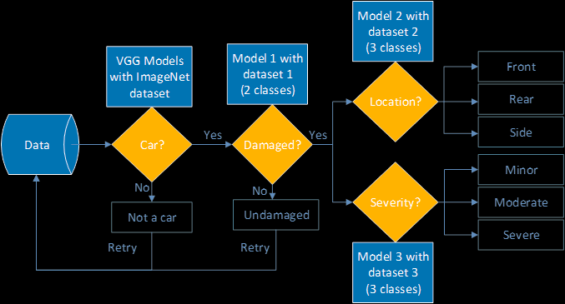
DATA FLOW DIAGRAM

Slide 18
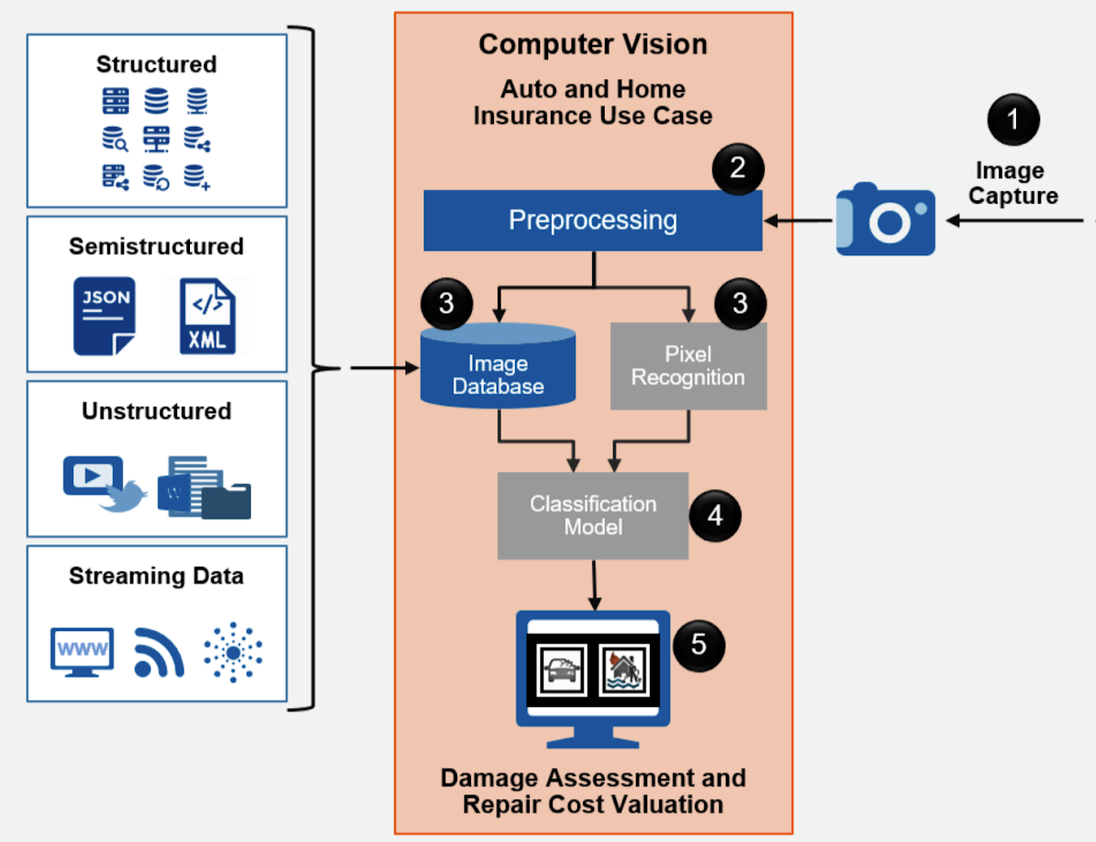
SYSTEM ARCHITECTURE

Slide 19
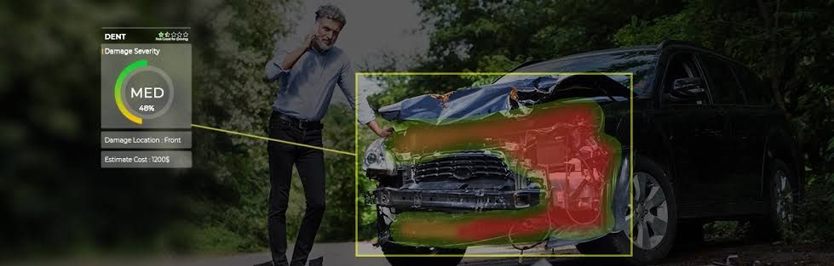
CONCLUSION
Vehicle damages are often seen in the modern world due to the immense usage of vehicles.
The drivers or the vehicle owners should spend a considerable amount of time on finding the severity of the damage and the cost to recover the damage according to the existing approaches.
Next the extracted features are taken into consideration and are classified into severity classes. Based on the severities of the damages, they are given an approximate cost utilizing a rule based engine.

Slide 20

FUTURE ENHANCEMENT
The work here merely lays ground for further, more detailed work in the field.
More rigorous estimation of human performance in these task might also be useful.
We could get more data by downloading images so that the training accuracy can be improve.
Using Cloud services to deploy the web app.

Slide 21

REFERENCE
[1] Sergei Gontscharov, “Algorithm Development for Minor Damage Identification in Vehicle Bodies Using Adaptive Sensor Data Processing”, 2014.
[2] J. P. Carmo en Joao Eduardo Ribeiro, “New Advances inVehicular Technology and Automotive Engineering”,.
[3] Chih-Fong Tsai, “No Title”, Bag-of-Words Represent. Image Annot. A Rev., 2012.

Slide 22

ANY QUERIES? THANK YOU

